Slide 1

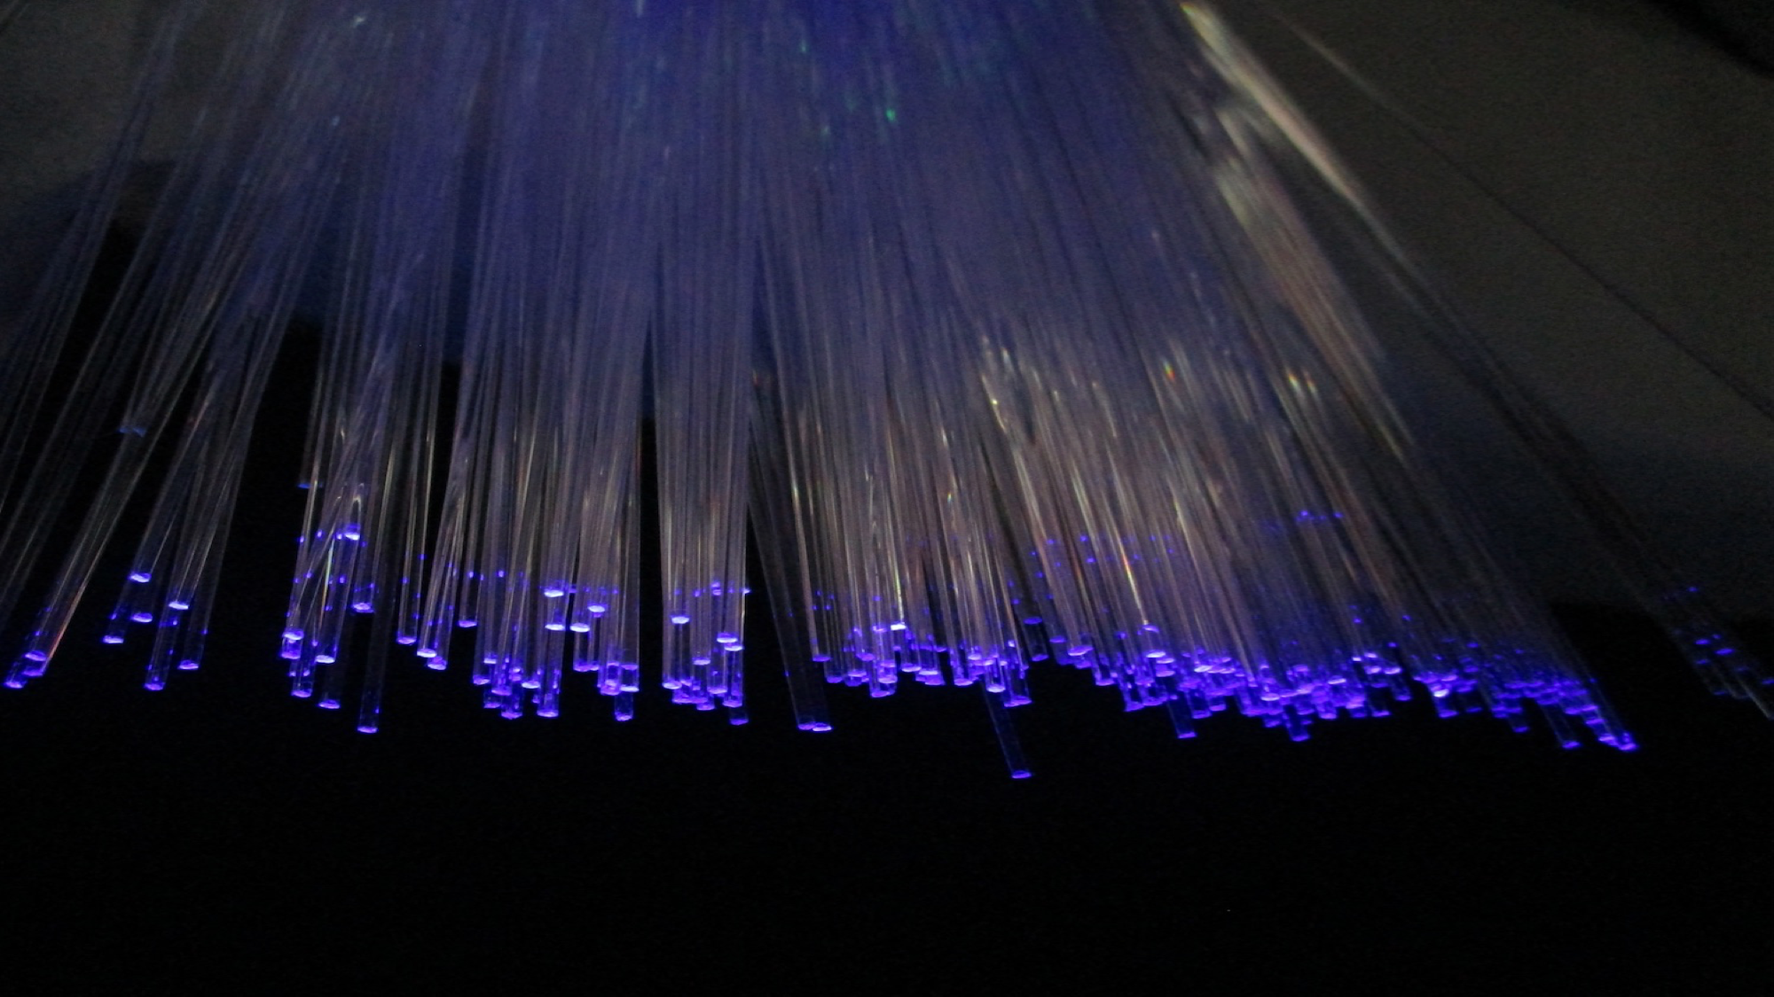
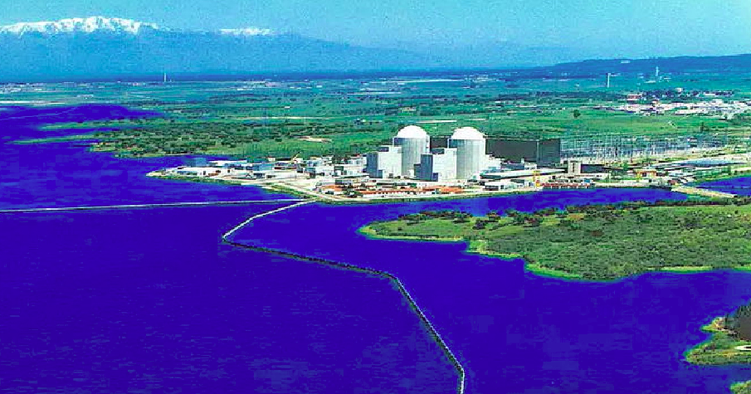
Departament de Física Atòmica, Molecular i Nuclear
TRITIUM: Design, Construction and Commissioning of an
In-Water Tritium Detector
Marcos Martínez Roig
Ph D. Dissertation
26th July 2022
Supervisors
José Díaz Medina
Nadia Yahlali Haddou
Notes:
<número>

